Slide 1
11/4/22

Slide 2
5.1
Anatomy of a Java Class

Slide 3
Definitions
Class - Blueprint for an object; instructions for how construct an object. There can be ONLY ONE of these -> "Dog"
Object - A particular instance of a class; use the new operator to create an object instance from a Class. There can be MANY of these -> "A 3 year-old German Shepherd named Roscoe", "A 1 year-old Golden Retriever named Lucy"
Properties and Methods - Properties are attributes (name, age, breed) and Methods are operations (play, eat, sleep); and each can be either public (available outside the Object) or private (available from only the inside of an Object)

Slide 4

Example Class
// Defining a Class
public class Dog {
public Dog(String name, int age) {
}
}
// Creating Objects
Dog scout = new Dog("Scout", 10);
Dog bailey = new Dog("Bailey", 5);

Slide 5
Writing a Class
public class Dog {
// Attributes
public String name;
private int age;
// Constructor
public Dog(String name, int age) { … }
// Methods
public int getAge() { … }
public void feedDog() { … }
private int calcFoodAmount() { … }
}

Slide 6
Instance Variables
Also known as attributes, properties, or fields
Holds the data of an object
Every Object instance has their own values for these properties
Dog scout = new Dog("Scout", 10); Dog bailey = new Dog("Bailey", 5);
scout.name.equals("Scout") == true bailey.name.equals("Bailey") == true scout.name.equals(bailey.name) == false

Slide 7
Instance Methods
Define the behavior generically in the Class
So that it can be used by every Object instance
public void feedDog() { System.out.println("Gave " + name + " a bowl of food."); }
Dog scout = new Dog("Scout", 10); Dog bailey = new Dog("Bailey", 5);
scout.feedDog(); "Gave Scout a bowl of food." bailey.feedDog(); "Gave Bailey a bowl of food."

Slide 8
Private vs Public
Private
An instance variable or method that can only be accessed within the class
On the AP Exam all instance variables should be private
Some methods can be private if they are only used internally
Public
An instance variable or method that can be accessed outside of a class like in the main method
Most methods are public

Slide 9
public properties and methods can be directly accessed from outside an object
OKAY Dog scout = new Dog("Scout", 10);
scout.name = "S-Dog"; scout.getAge(); scout.feedDog();
ERROR scout.age = 5; scout.calcFoodAmount();
public class Dog {
// Attributes
public String name;
private int age;
// Constructor
public Dog(String name, int age) { … }
// Methods
public int getAge() { … }
public void feedDog() { … }
private int calcFoodAmount() { … }
}

Slide 10
private properties and methods can be accessed only from within an object
Question: Why might we want code outside Dog from modifying age or calling calcFoodAmount()?
public class Dog {
// Attributes
public String name;
private int age;
// Constructor
public Dog(String name, int age) { … }
// Methods
public int getAge() { … }
public void feedDog() { … }
private int calcFoodAmount() { … }
}

Slide 11
Object-Oriented Design
A design philosophy used by programmers when developing larger programs
Decide what classes you’ll need to solve a problem
Define the data (instance variables) and functionality (methods) for the classes
Utilize classes and objects to solve your problem

Slide 12

Data Encapsulation
Data (instance variables) and the code acting on it (methods) are wrapped together in a single implementation and the details are hidden.
Data is safe from harm by keeping it private

Slide 13
public class Dog {
// Attributes
public String name;
private int age; // Constructor
public Dog(String name, int age) {
this.name = name; this.age = age;
} // Methods
public int getAge() {
return age;
}
public void feedDog() {
System.out.println("Gave " + name + " " + calcFoodAmount() + " of food.");
}
private String calcFoodAmount() {
if (age < 6) {
return "3 bowls";
}
return "1 bowl";
}
}

Slide 14
public class Dog {
// Attributes
public String name;
private int age; // Constructor
public Dog(String name, int age) {
this.name = name; this.age = age;
} // Methods
public int getAge() {
return age;
}
public void feedDog() {
System.out.println("Gave " + name + " " + calcFoodAmount() + " of food.");
}
private String calcFoodAmount() {
if (age < 6) {
return "3 bowls";
}
return "1 bowl";
}
}

Slide 15
public class Dog {
// Attributes
public String name;
private int age; // Constructor
public Dog(String name, int age) {
this.name = name; this.age = age;
} // Methods
public int getAge() {
return age;
}
public void feedDog() {
System.out.println("Gave " + name + " " + calcFoodAmount() + " of food.");
}
private String calcFoodAmount() {
if (age < 6) {
return "3 bowls";
}
return "1 bowl";
}
}

Slide 16
public class Dog {
// Attributes
public String name;
private int age; // Constructor
public Dog(String name, int age) {
this.name = name; this.age = age;
} // Methods
public int getAge() {
return age;
}
public void feedDog() {
System.out.println("Gave " + name + " " + calcFoodAmount() + " of food.");
}
private String calcFoodAmount() {
if (age < 6) {
return "3 bowls";
}
return "1 bowl";
}
}

Slide 17

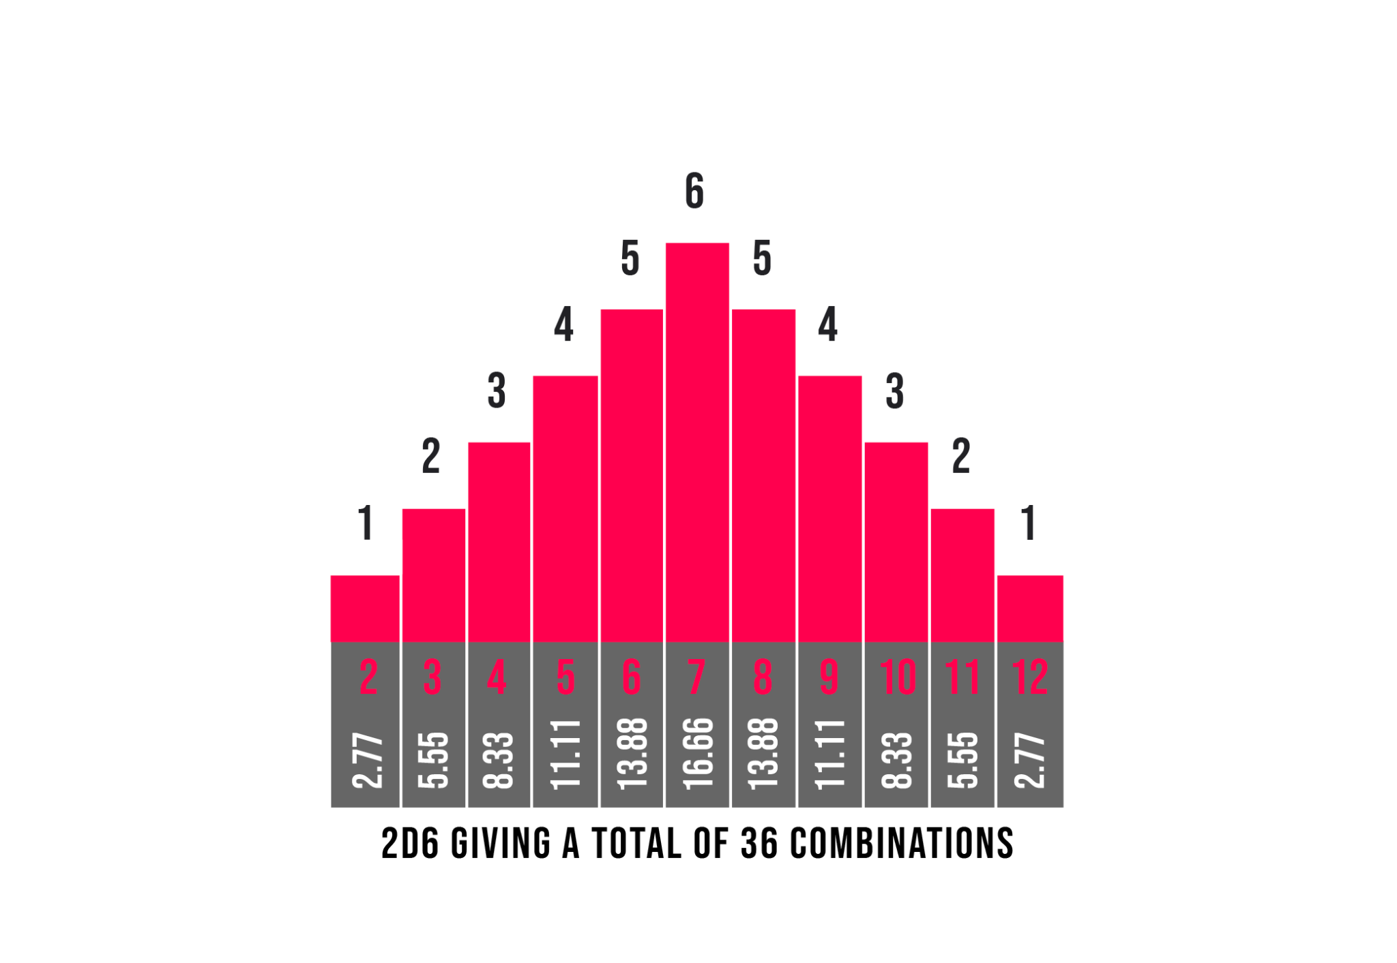
Practice
Complete all the activities for 5.1 on CSAwesome
RefactorMe replit
In computer programming and software design, code refactoring is the process of restructuring existing computer code—changing the factoring—without changing its external behavior. Refactoring is intended to improve the design, structure, and/or implementation of the software (its non-functional attributes), while preserving its functionality.
https://en.wikipedia.org/wiki/Code_refactoring

